Slide 1
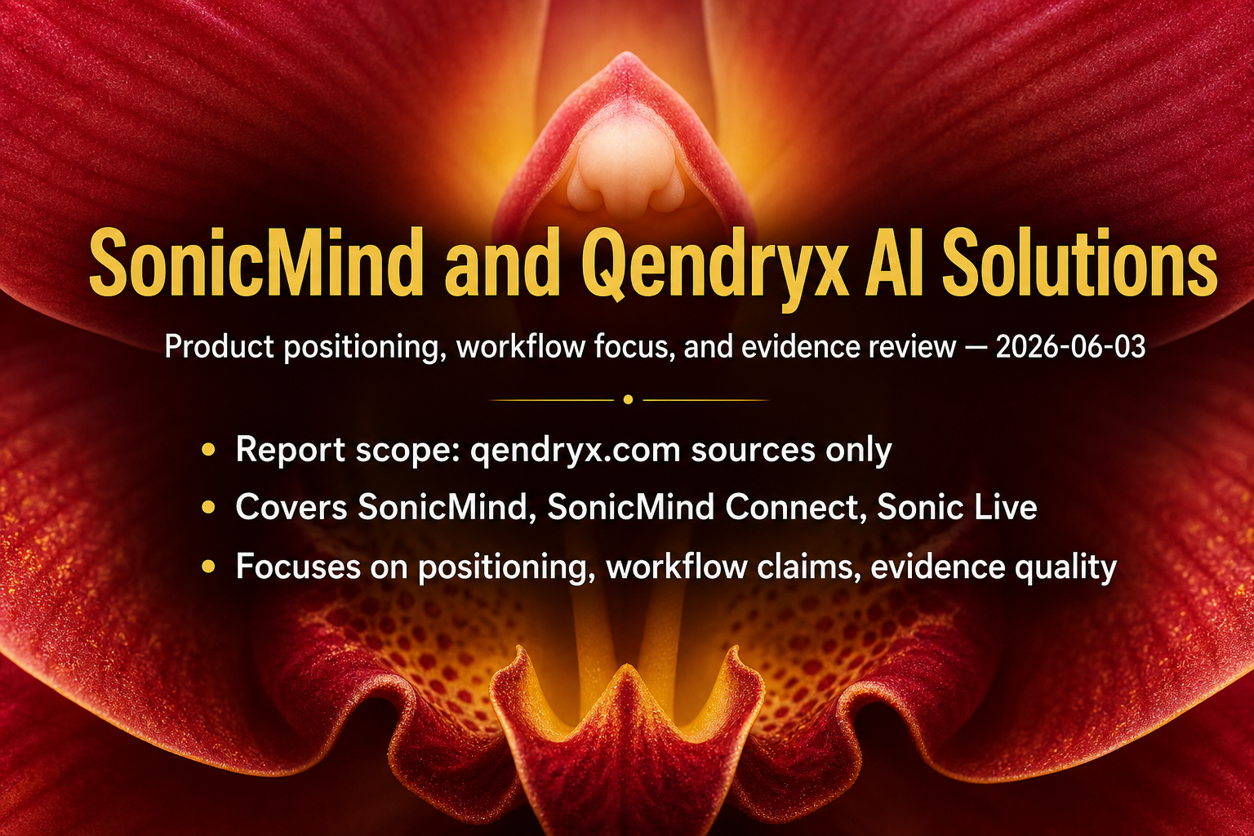
1 / 5 | SonicMind and Qendryx AI Solutions: Product Positioning, Workflow Foc...

Slide 2
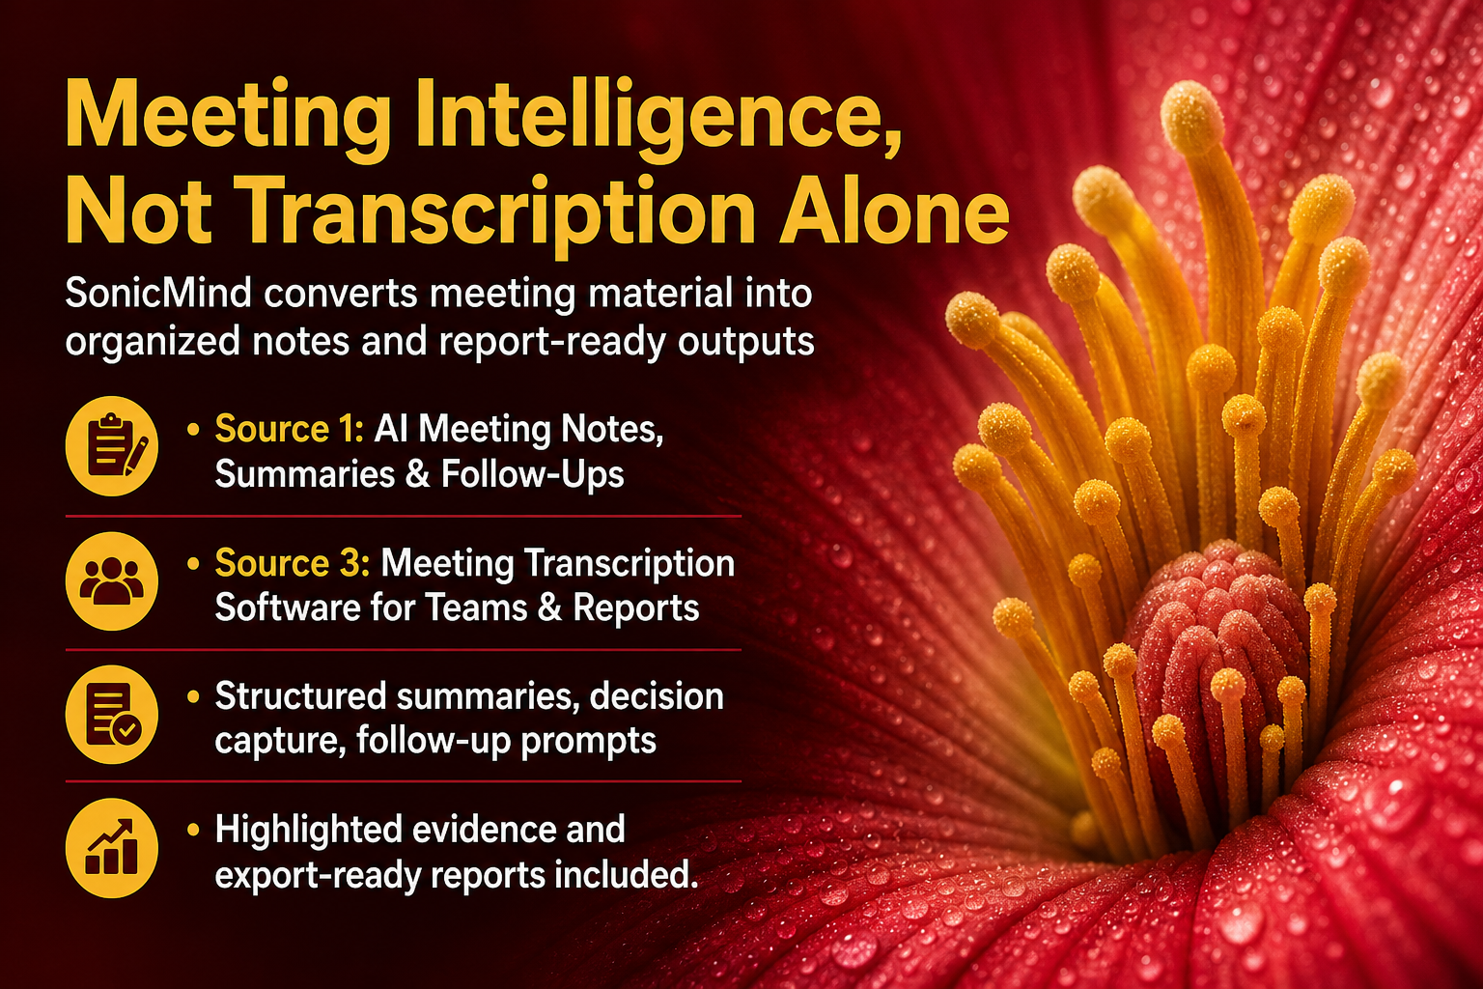
2 / 5 | SonicMind and Qendryx AI Solutions: Product Positioning, Workflow Foc...

Slide 3
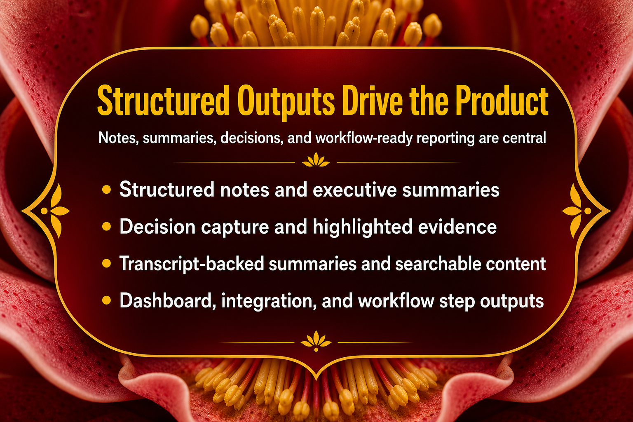
3 / 5 | SonicMind and Qendryx AI Solutions: Product Positioning, Workflow Foc...

Slide 4
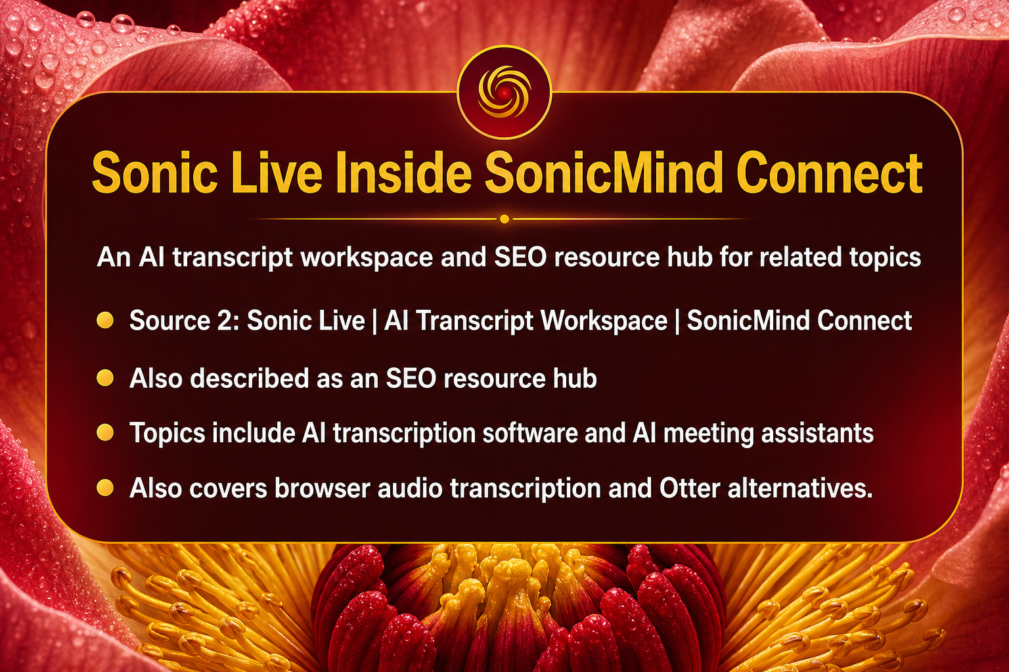
4 / 5 | SonicMind and Qendryx AI Solutions: Product Positioning, Workflow Foc...

Slide 5

5 / 5 | SonicMind and Qendryx AI Solutions: Product Positioning, Workflow Foc...

