Slide 1
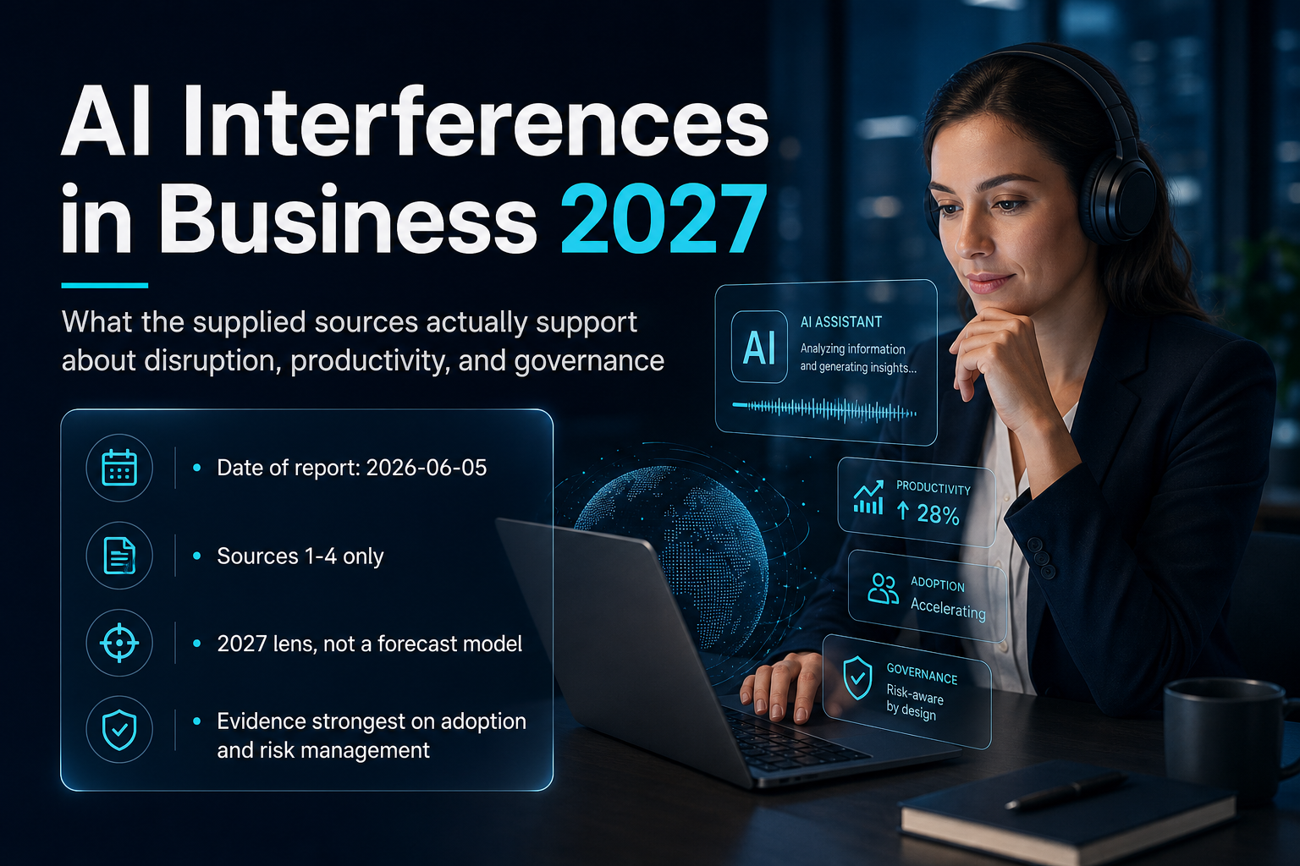
1 / 5 | AI Interferences in Business 2027: What the Evidence Actually Supports

Slide 2

2 / 5 | AI Interferences in Business 2027: What the Evidence Actually Supports

Slide 3
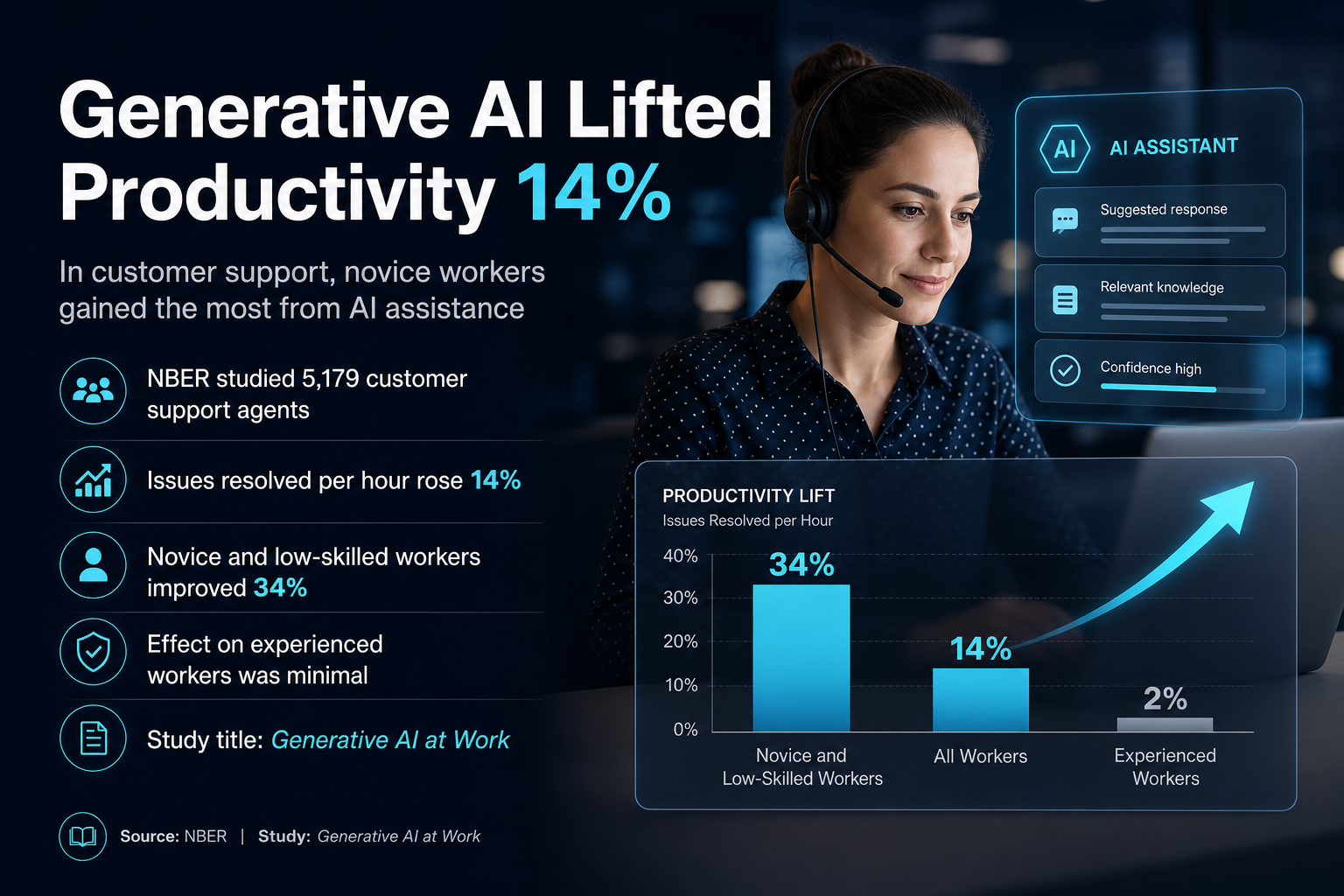
3 / 5 | AI Interferences in Business 2027: What the Evidence Actually Supports

Slide 4
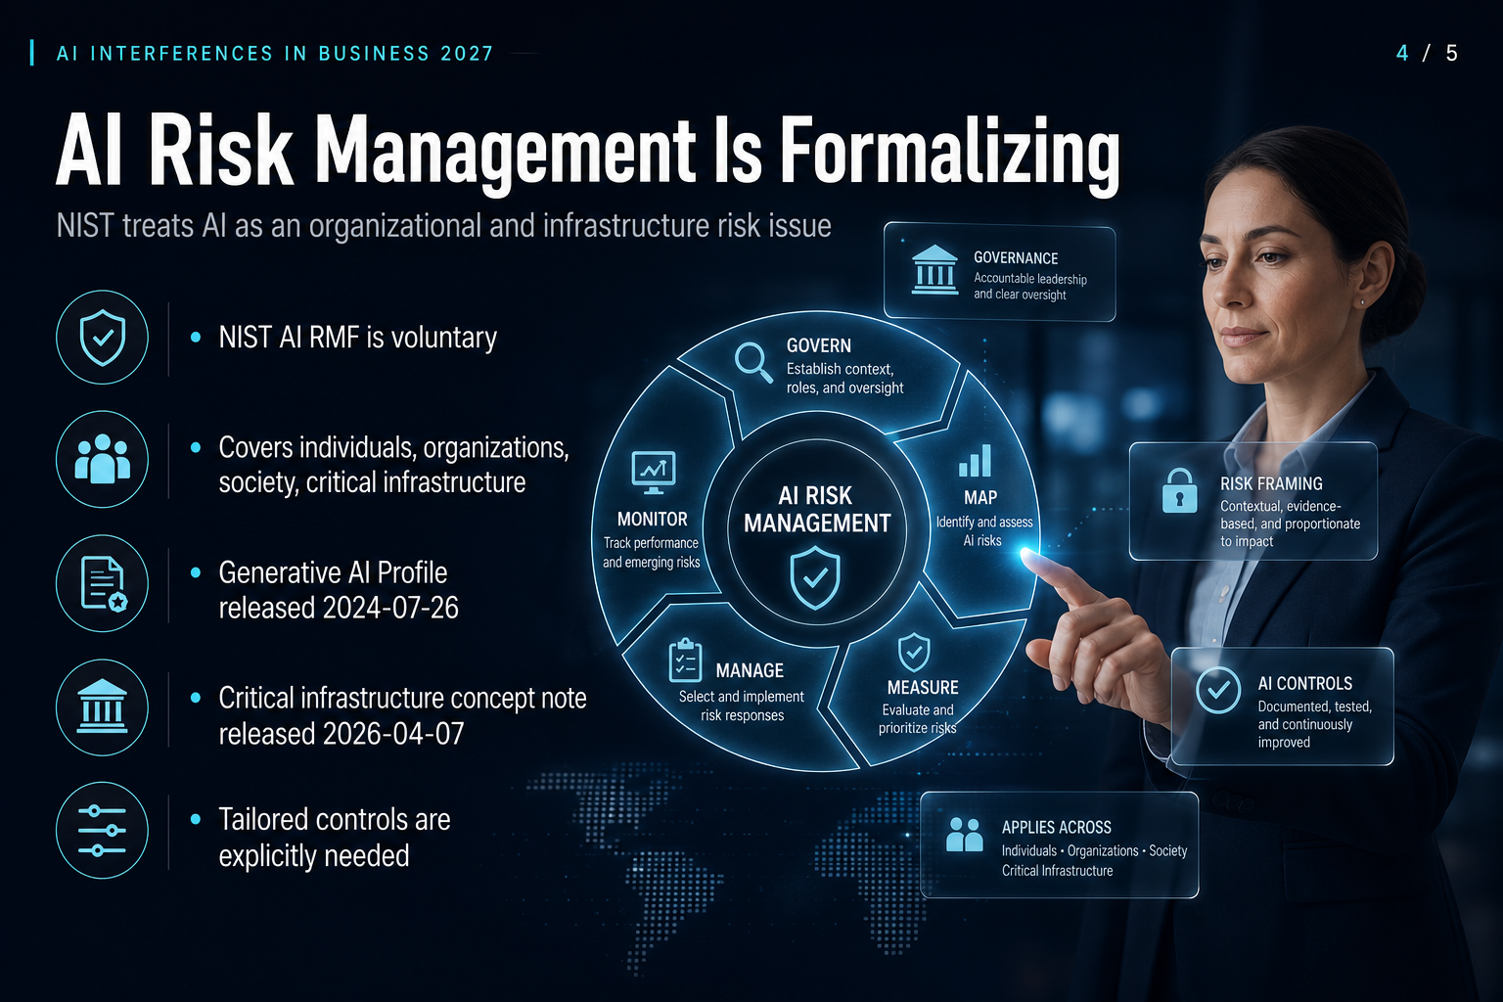
4 / 5 | AI Interferences in Business 2027: What the Evidence Actually Supports

Slide 5
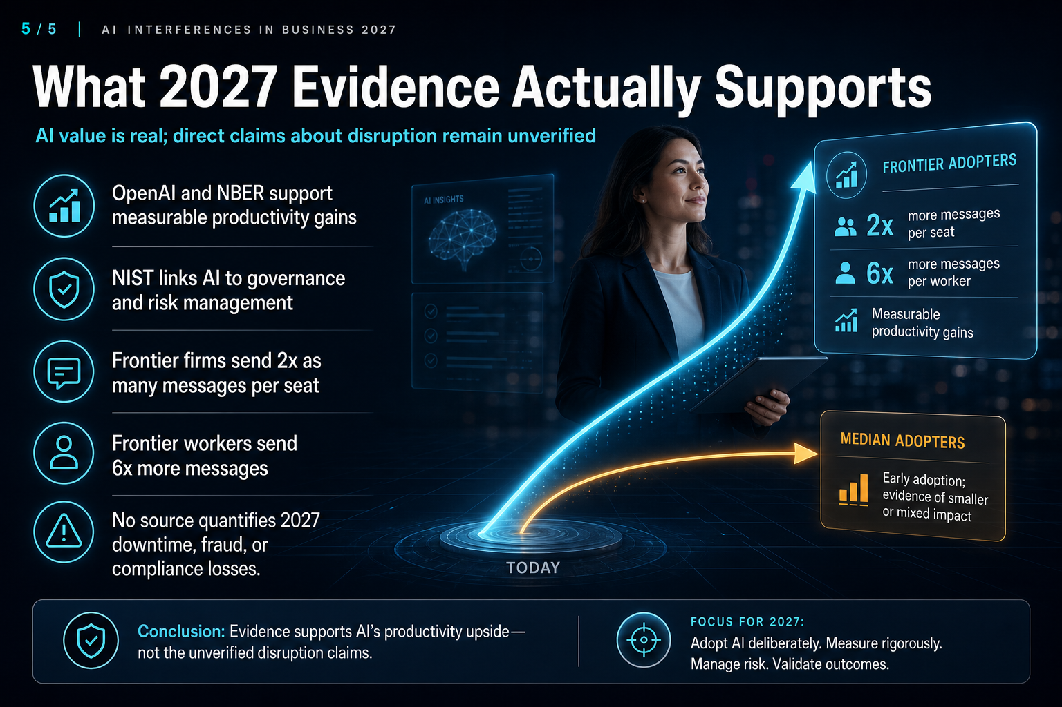
5 / 5 | AI Interferences in Business 2027: What the Evidence Actually Supports

